Slide 1
Random Numbers
By
Dr. Sikander M. Mirza
Department of Physics and Applied Mathematics
Pakistan Institute of Engineering and Applied Sciences
Nilore, Islamabad 45650, Pakistan

Slide 2
Introduction
Many processes in nature appear random in nature: radioactive decay, lightening, flow in lava lamp and earthquakes etc.
Many argue that they appear random because we do not have sufficient details of the underlying processes.
Whatever the reason, simulation of such processes requires generation of random numbers.
Are all random processes basically the same?
Yes, at very elementary level, all randomness is like tossing a coin: Head or Tail.
So, we need random numbers to mimic the basic level.

Slide 3
Introduction
There are two types of random numbers:
True
Pseudo
The ‘True: random numbers are obtained by using some natural phenomenon – like measuring radioactive decays taking place in fixed intervals of time. Here, a long lived source is taken (e.g., Cs-137, with half life close to 30 years) and we measure the number of decays in two minutes. This number is expected to be random.
Such an apparatus makes a true random number generator (TRN-Generator).
Main advantage of a TRN-generator is reliability. It can be treated as Gold-Standard as far as random numbers are concerned.

Slide 4
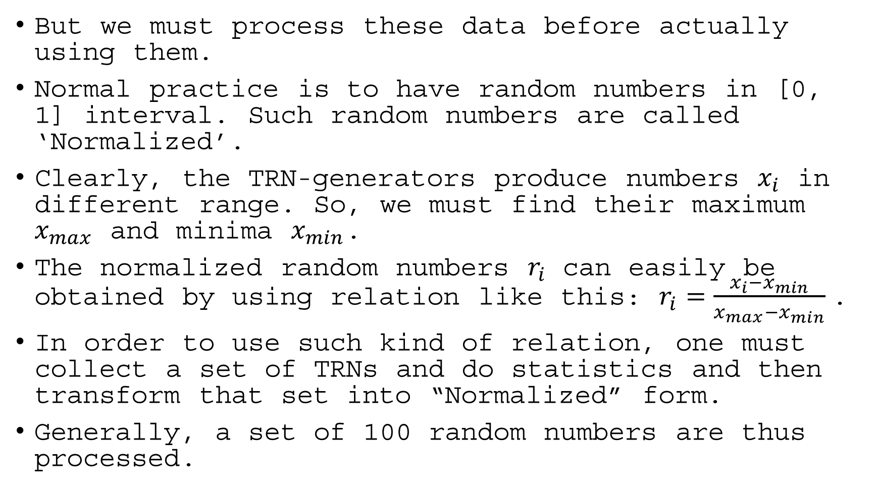
Introduction
But we must process these data before actually using them.
Normal practice is to have random numbers in [0, 1] interval. Such random numbers are called ‘Normalized’.
Clearly, the TRN-generators produce numbers $x_{i}$ in different range. So, we must find their maximum $x_{max}$ and minima $x_{min}$.
The normalized random numbers $r_{i}$ can easily be obtained by using relation like this: $r_{i}=\frac{x_{i}−x_{min}}{x_{max}−x_{min}}$.
In order to use such kind of relation, one must collect a set of TRNs and do statistics and then transform that set into “Normalized” form.
Generally, a set of 100 random numbers are thus processed.

Slide 5
Introduction
Therefore, TRN-generators are sort of delayed process.
One must eliminate ‘natural’ bias or non-uniform behavior of such TRNs.
TRN-generators can be used to collect large sets of random numbers and use them when needed.
In some applications,we need millions of random numbers. For such cases, we actually need huge data from such generators. This requires pre-collection of data, which means keeping the TRn-generators on for a long time… which involves cost, time and resources.

Slide 6
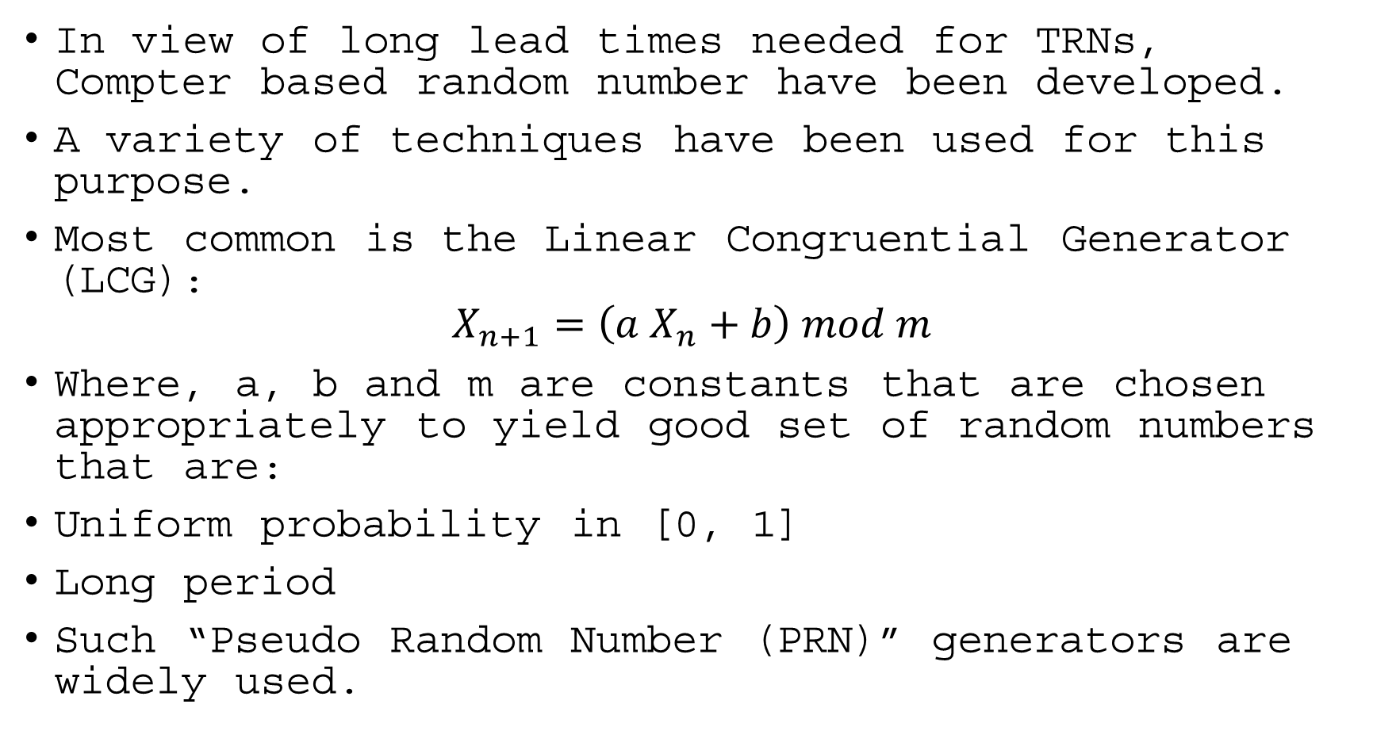
Introduction
In view of long lead times needed for TRNs, Compter based random number have been developed.
A variety of techniques have been used for this purpose.
Most common is the Linear Congruential Generator (LCG):
$$X_{n+1}=\left(a X_{n}+b\right) mod m$$
Where, a, b and m are constants that are chosen appropriately to yield good set of random numbers that are:
Uniform probability in [0, 1]
Long period
Such “Pseudo Random Number (PRN)” generators are widely used.

Slide 7
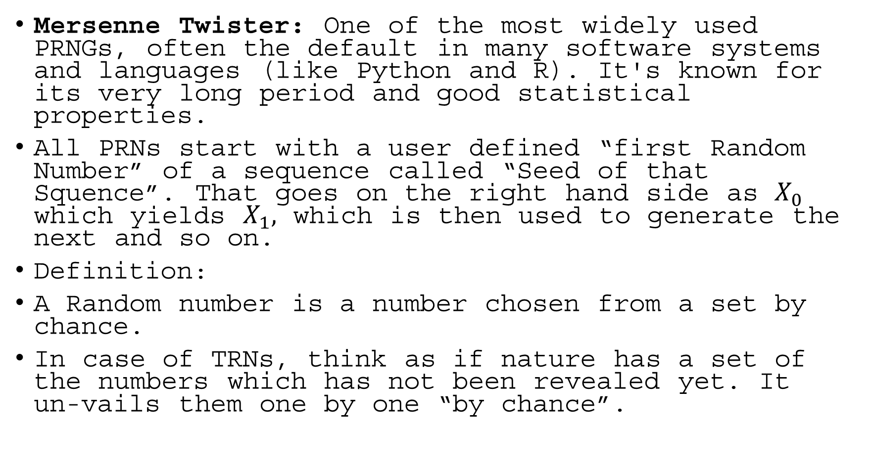
Introduction
Mersenne Twister: One of the most widely used PRNGs, often the default in many software systems and languages (like Python and R). It's known for its very long period and good statistical properties.
All PRNs start with a user defined “first Random Number” of a sequence called “Seed of that Squence”. That goes on the right hand side as $X_{0}$ which yields $X_{1},$ which is then used to generate the next and so on.
Definition:
A Random number is a number chosen from a set by chance.
In case of TRNs, think as if nature has a set of the numbers which has not been revealed yet. It un-vails them one by one “by chance”.

Slide 8
Characteristics of Random Numbers
Uniform distribution over a defined interval
Same probability of finding any number in [0,1] interval
OR Flat frequency profile for all groups of random numbers having same class width.
Independence and unpredictability
Although, LCGs are based on a mathematical relation, one should not be able to predict next random number by just looking at any collection of random numbers generated by it.
In other words, by looking at the “output” discovery of the constant a,b an m
Examples of random sequences vs non-random sequences
0.32, 0.19, 0.67, 0.43, 0.98… is random
1, 5, 13, 29 , … is not random as it is just; (2x+3)

Slide 9
Uses and Applications
Statistical sampling and inference
In sampling, random numbers are primarily used to select individuals or items from a population such that the sample is representative and unbiased. This process is known as probability sampling.
Sampling Types: (i) Simple, (ii) Systematic (iii) Stratified Sampling
In statistical inference, random numbers are critical for developing and validating models, testing hypotheses, and quantifying uncertainty.
For example, in drug testing, placebo and actual drug are used with “random” profile to draw valid conclusions from treatment data.
Computer simulations and modeling
Random variables are absolutely fundamental to computer simulation and models, serving as the mechanism to introduce real-world uncertainty, variability, and randomness into a computational environment. They allow models to capture the stochastic (probabilistic) nature of complex systems

Slide 10
Uses and Applications
Discrete event simulations: (i) Queueing systems (ii) Manufacturing
Cryptography and secure communications
Random variables are fundamental to cryptography and secure communication because they provide the necessary unpredictability (or entropy) upon which the entire system's security relies.
In this field, a random variable is the mathematical model used to describe the creation of secret,
Specialized Random number generators, typically layered, are used for security of data and communication.
These RNGs are highly robust, reliable and best tested not fail.
They are also tested against hacking and data corruption such that any attempt to read/change them renders them useless and a new secure channel positions in place.
These typically have layered protocals with over-sized redundancy to ensure crystal clear communication even over the noisiest channels.

Slide 11
Uses and Applications
Games of chance (Computer Games)
Clearly, the randomness in computer games makes them interesting and playable. There are many ways in which the randomness is used in games including:
Hit or Miss
Rewards and losses
Action completion including jumps/falls/dive
Weather environment changes rain/wind/clouds, fire/smoke
Scene generation: Layout/trees/grass
Gestures and Actions

Slide 12
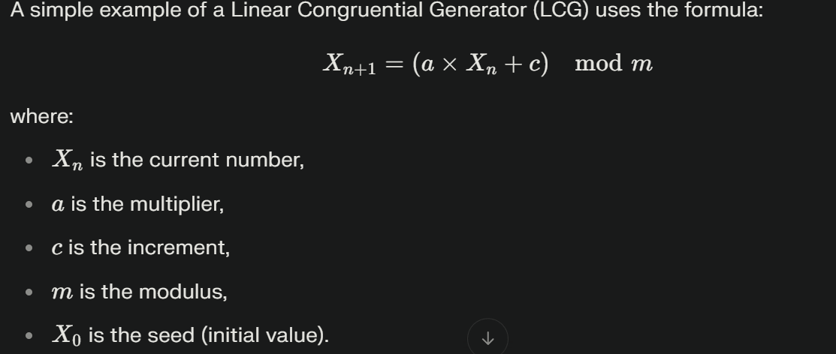
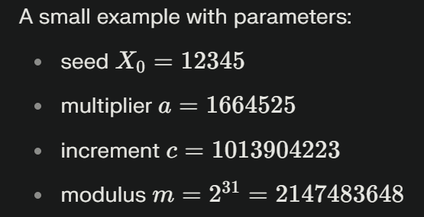
Pseudo Random Numbers

Slide 13
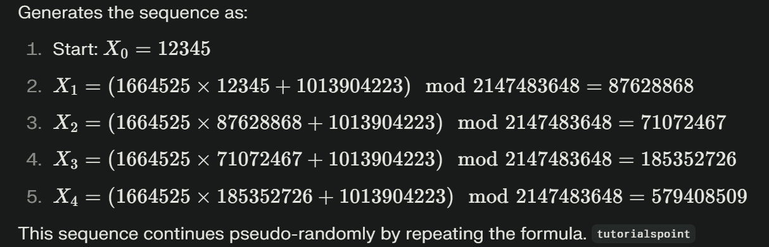

Pseudo Random Numbers

Slide 14
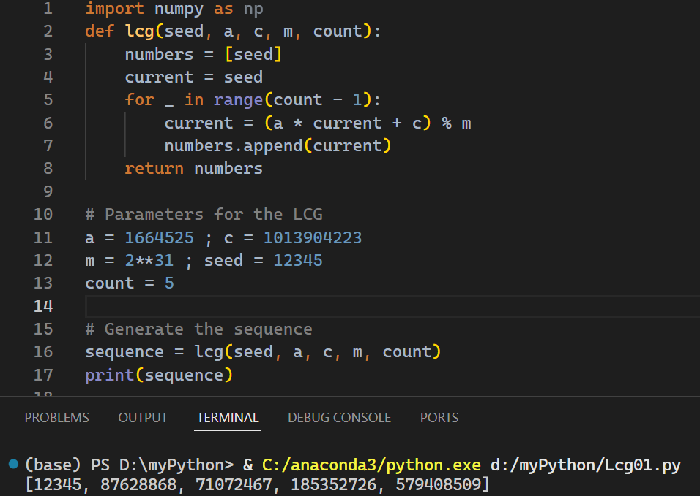
Pseudo Random Numbers

Slide 15
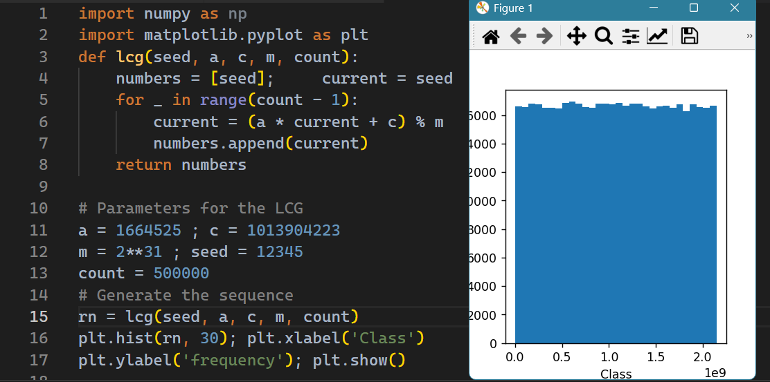
Pseudo Random Numbers

Slide 16
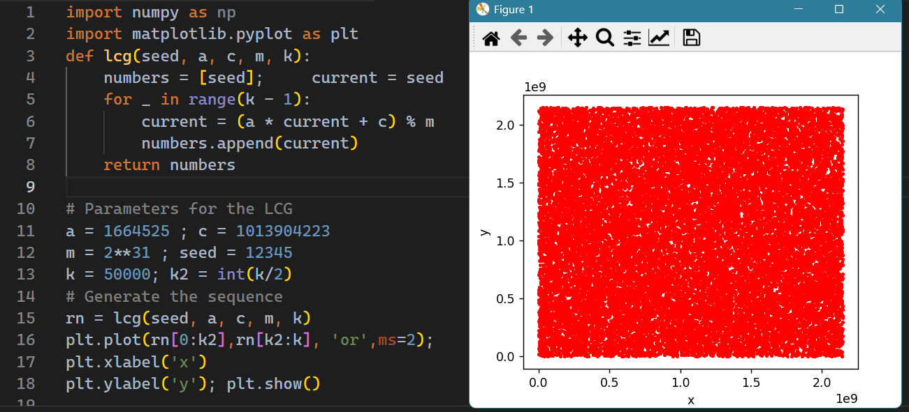
Pseudo Random Numbers

